Slide 1

Multi-function bluetooth pedometer based on 9-axis sensor
Team 5
105061254 林士平
105061222 黃楠峻

Slide 2
Outline
Introduction
Method
Current progress
Final Goal

Slide 3
Introduction
Goal: Design wearable pedometer device
Function: Display step
Setting: Through cell phone by reset number of step

Slide 4
Method
1. Arduino Hardware
2. Collect Data from Arduino to Matlab
3. Signal Processing in Matlab
4. Algorithm and Block Diagram
5. Implement Algorithm in Arduino

Slide 5
Arduino Hardware

Slide 6
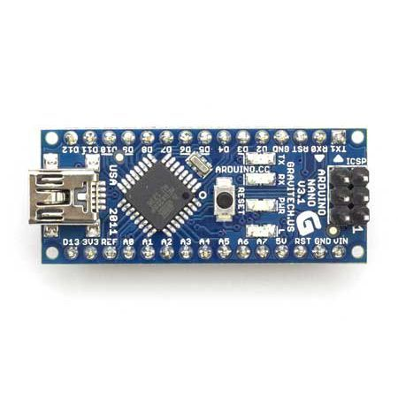
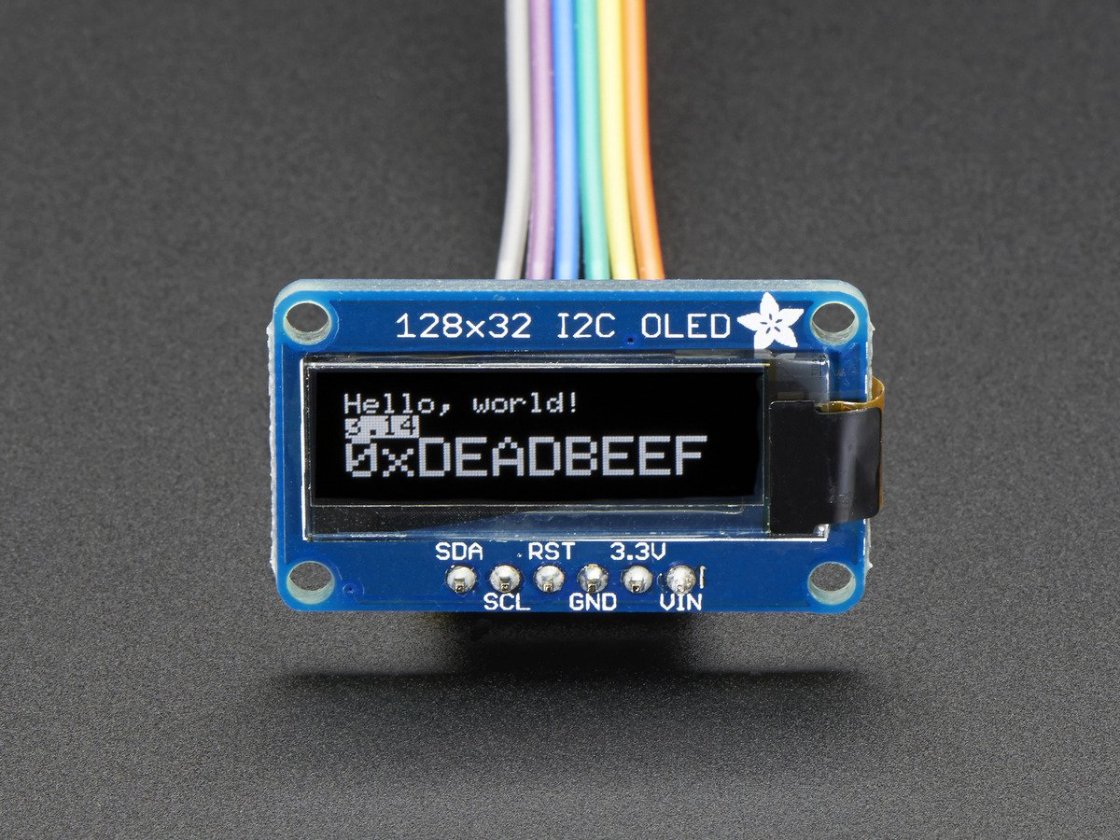
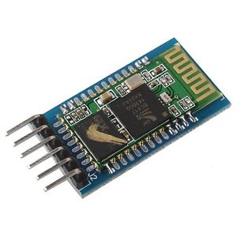
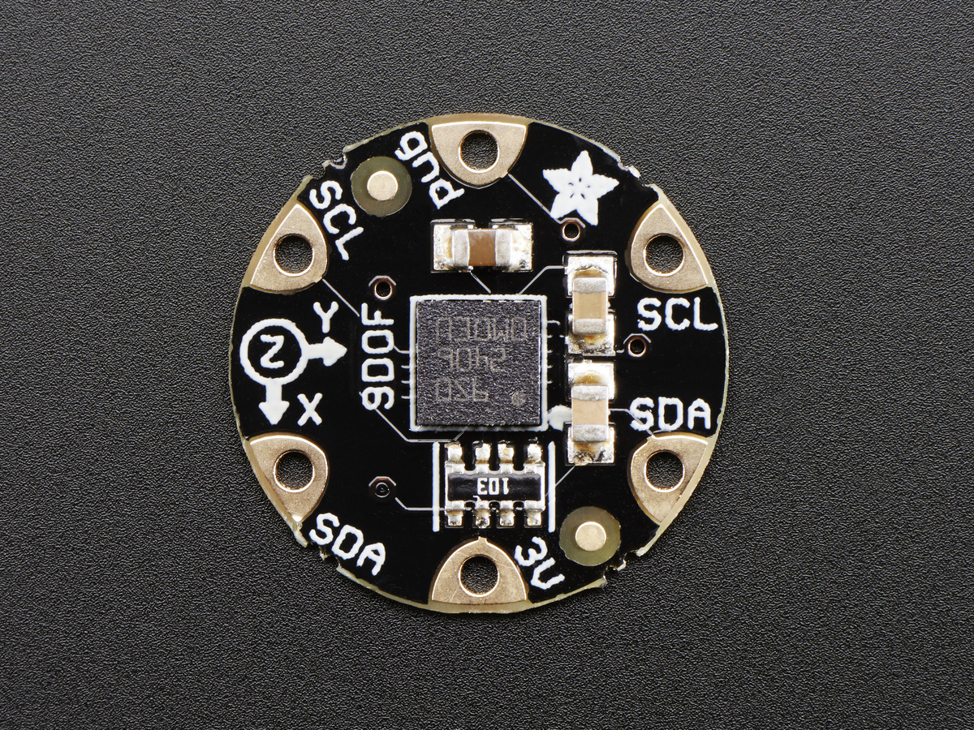
Arduino
Material
Notes:
Picture of material : 1. Uno board -> Nano board 2. Display large -> small 3. Accelerometer v1 -> v2 4. Bluetooth off board -> on bard

Slide 7
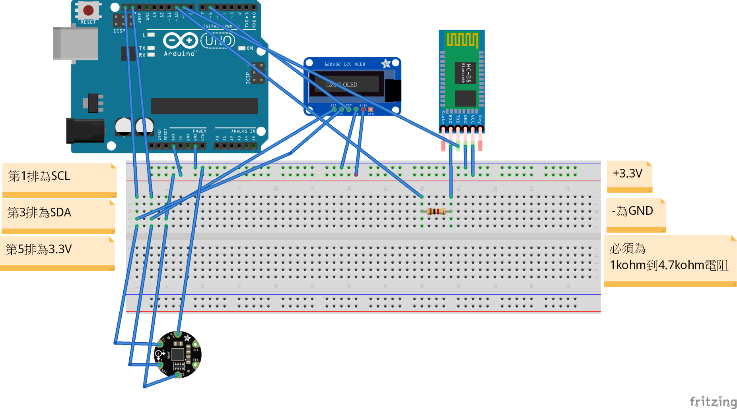
Hardware circuit

Slide 8
Collect Data from Arduino to Matlab

Slide 9
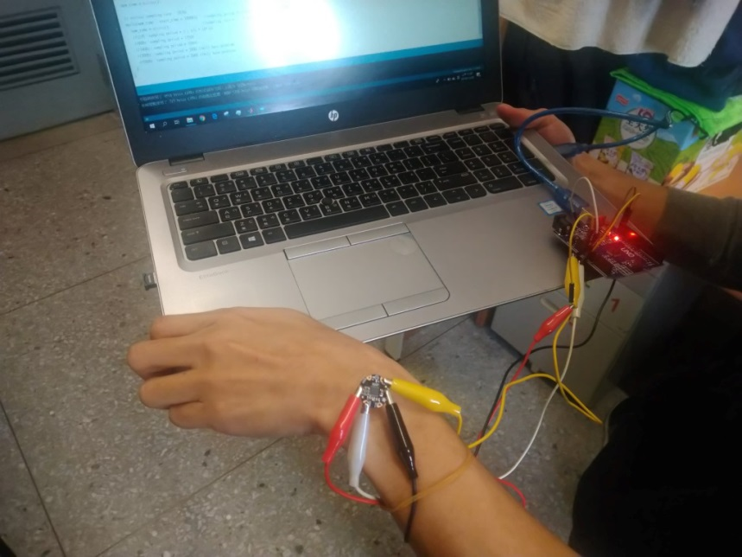
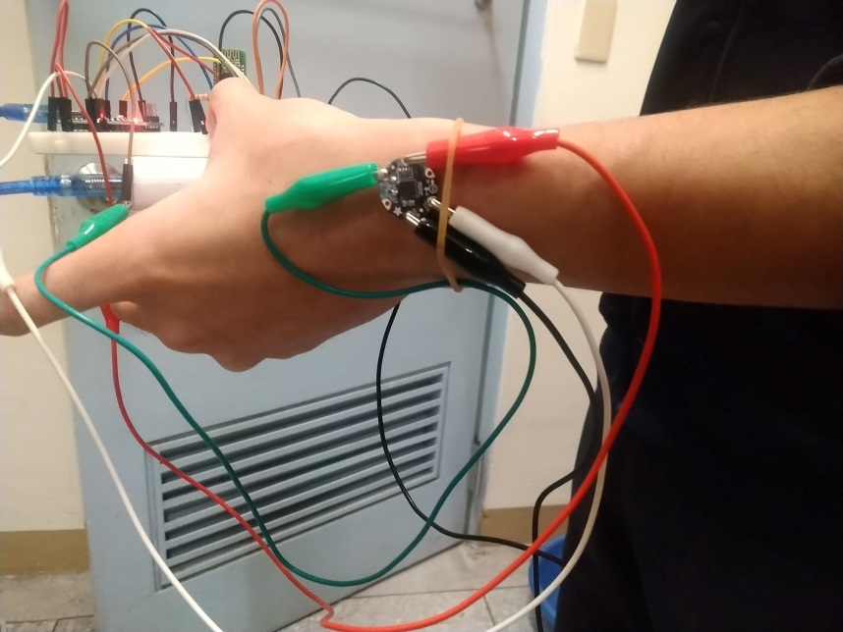
Collect Data
Strategy
Obtain signal from accelerometer through ADC of Arduino
board (similar to Unit 1)

Slide 10
Signal Processing
in Matlab

Slide 11
Matlab
Signal Processing
Process signal from accelerometer
1. Use one-axis or three-axis acceleration signal (Sum of
absolute value / Root of sum square value)
2. Filter signal of acceleration through different window
function
3. Find peak of the step

Slide 12
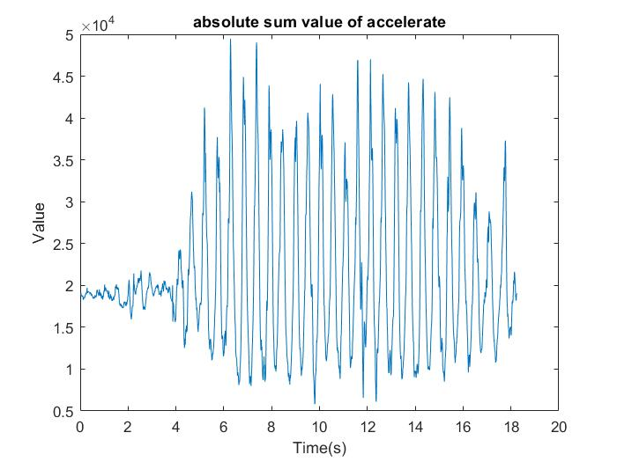
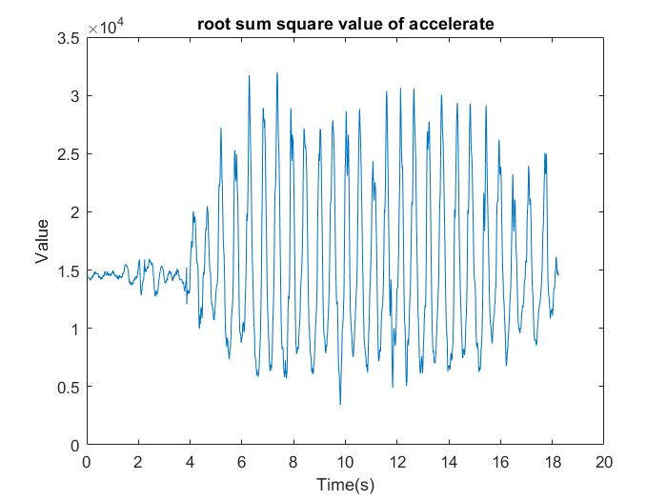
Matlab
Sum of absolute value vs. Root of sum square

Slide 13
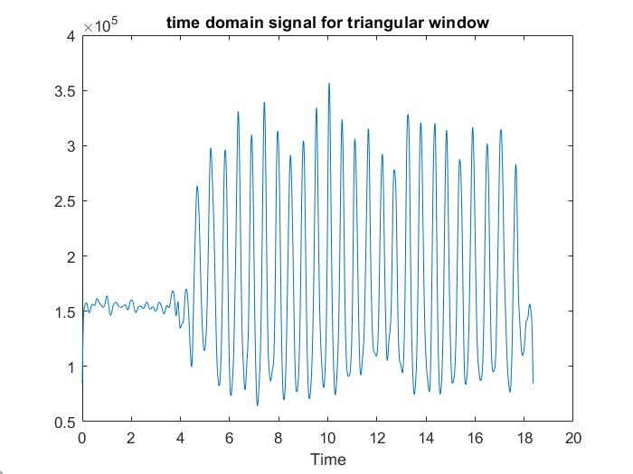
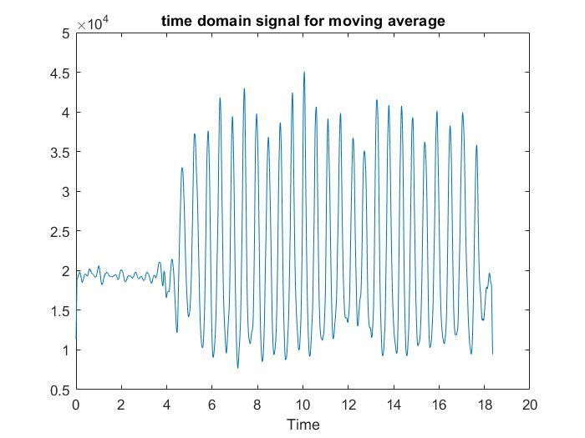
Matlab
Triangular window vs. Moving average

Slide 14
Matlab
Algorithm to find step
1. Buffer to store 2N+1 values: If N difference between
two neighboring value <0 and N difference between
two neighboring value >=0, then N+1th value is local
maximum (peak) or minimum (valley).
2. Peak-valley > threshold value (dynamic)
3. Interval between pairs of peak/valley needs to between
0.2~2 (Hz)

Slide 15
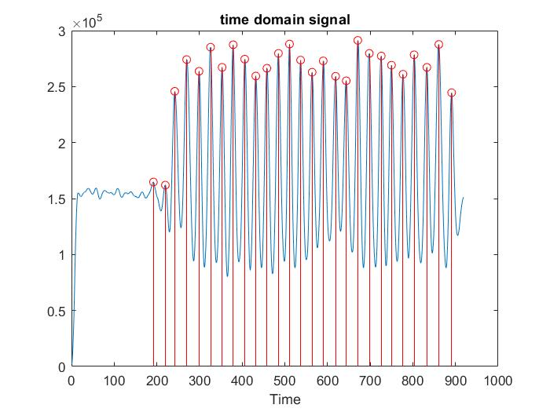
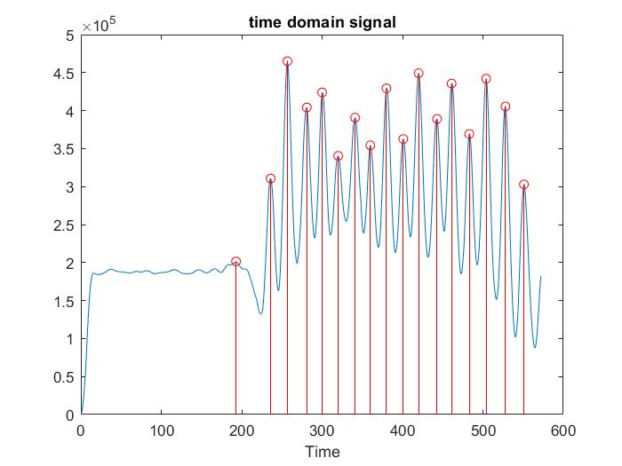
Matlab
Step of walk and run
Walk
Run

Slide 16
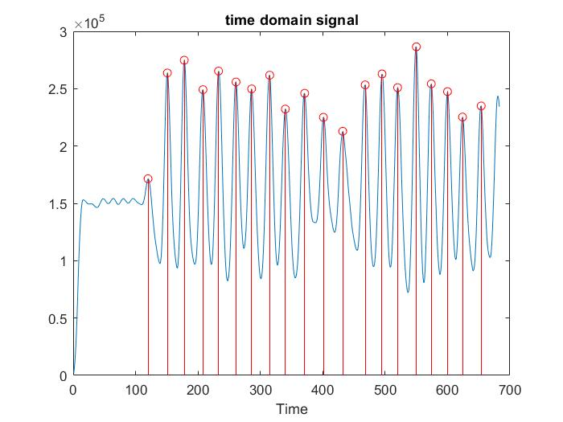
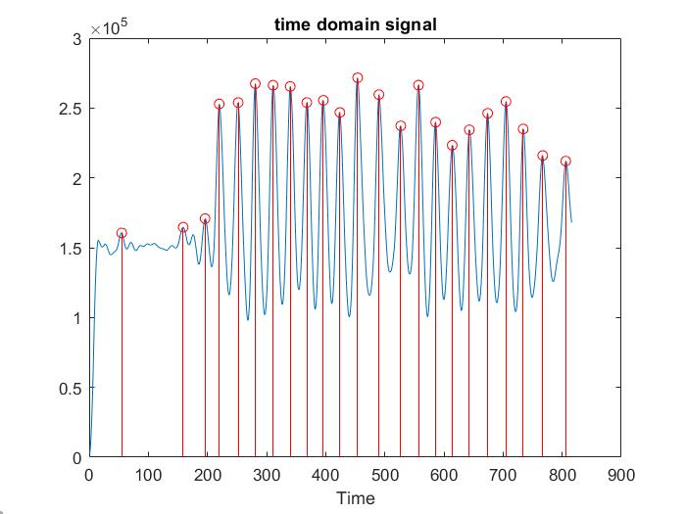
Matlab
Step of downstairs and upstairs
Downstairs
Upstairs

Slide 17
Algorithm and
Block Diagram

Slide 18
Block diagram
Read data
Sum of absolute value
Triangular window
Difference filter
Find peak and valley
No
Peak-valley>threshold && in time window
Step
Yes

Slide 19
Implement Algorithm in Arduino

Slide 20
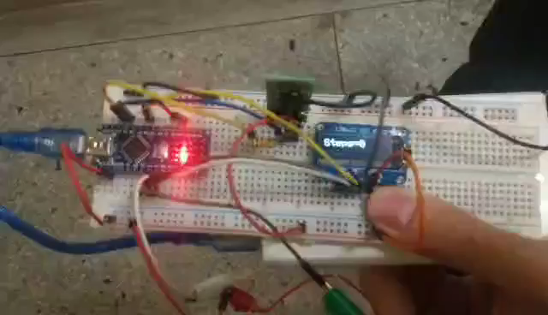
Current Progress
Video

Slide 21
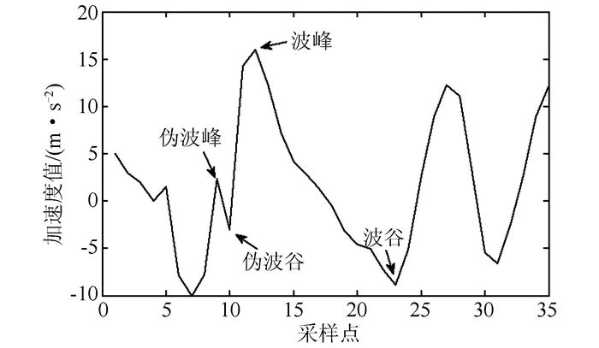
Current Difficulty
Difficulties
fake peaks & fake valleys

Slide 22
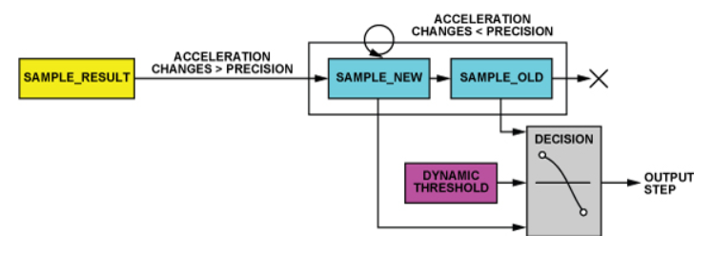
Current Difficulty
Possible strategy
1. using more appropriate filter to smooth the signals.
2. tuning sampling rate.
3. using new algorithm shown below :

Slide 23
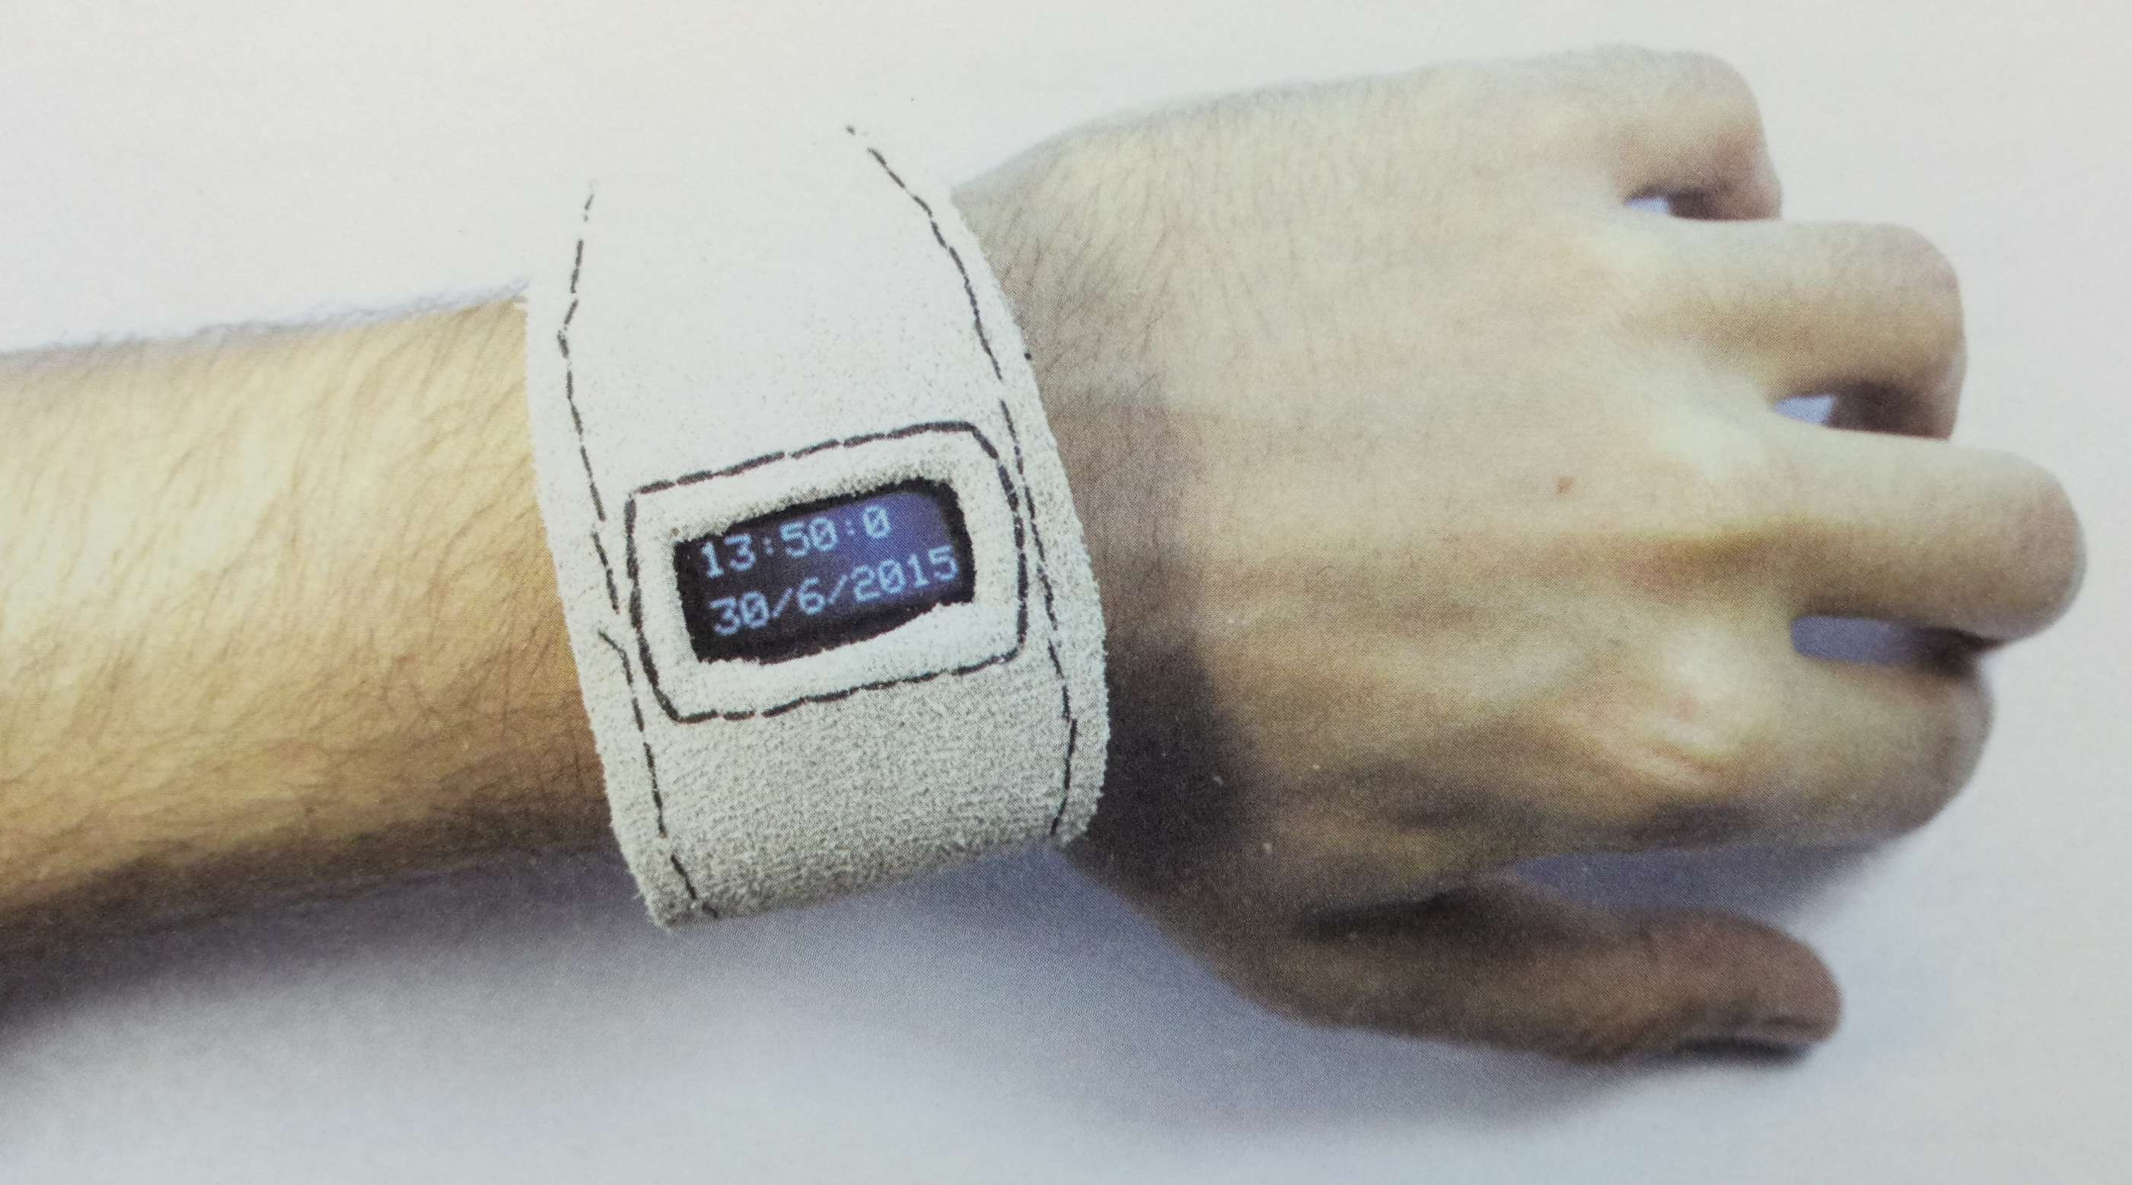
Final Goal

Slide 24
Thank you!

